Slide 1
Why Children Absorb More Microwave Radiation than Adults: The Consequences
20 April 2014
2nd Symposium on ''Controversies on Electromagnetic Field in Medicine and Biology”
King Abdulaziz University, Jeddah, Saudi Arabia
L. Lloyd Morgan, Senior Research Fellow,
Environmental Health Trust
Notes:
I am honored to be here I want to thank the organizers’ Professor Al-Hayani and Professor Mustafa.
Please make sure your cellphone are off.

Slide 2
Topics
Children absorb more microwave radiation (MWR) than adults
Fetus at greater risk than children
Risk of brain cancer from cellphone use in children and teenagers
Risk of other tumors
Risk of sperm damage
MWR is a Class 2B (possible) Carcinogen
Myelin degeneration from MWR exposures
Cellphones place in bras: risk for multiple primary breast cancers
Latency time (from first exposure to diagnosis)
Cellphone manual warnings & 20 centimeter rule of tablets and laptops
Toys for infants and toddlers
Digital dementia
Government warnings
Notes:
2
The topics I will cover are:

Slide 3
Children Absorb > MWR than Adults
Computer simulation using MRI scans of children
Absorption penetrates deeper into brain [1]
Children absorb MWR 2x in the brain and 10x in bone marrow than adults [2,3]
Hippocampus and hypothalamus absorb 1.6–3.1 higher and the cerebellum absorb 2.5 times higher MWR compared to adults [4]
Notes:
3
Children’s brains have more water, their skulls are thinner and their head is smaller than an adults’

Slide 4
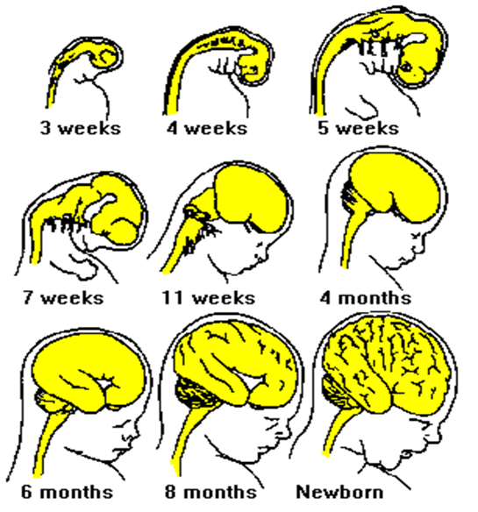
Risk to Fetus
Brain grows rapidly throughout embryonic & early life
Hugh Taylor, 2013
Adapted slide courtesy of Dr. Devra Davis
Notes:
4
The risk to the fetus is even higher than children, particularly because the brain and other organs are developing in a complex cell differentiation process. MWR can affect this brain development process. Such developmental problems may explain the world-wide autism epidemic.

Slide 5
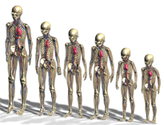
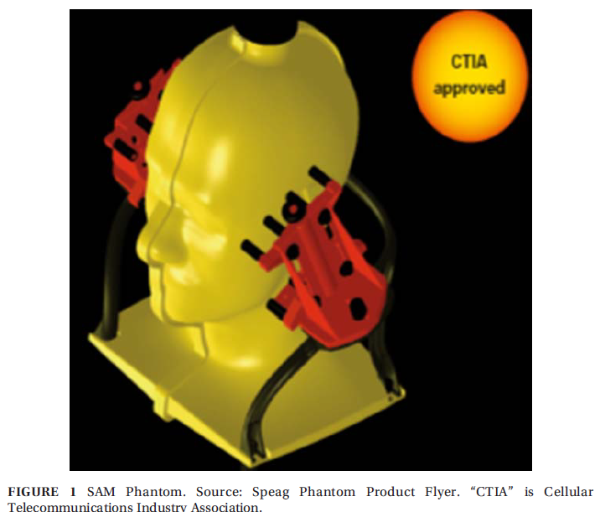
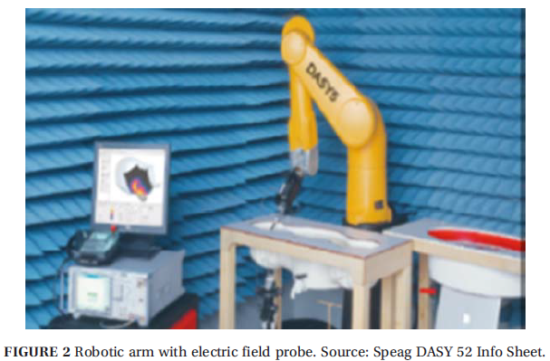
Two Methods to Certify Cellphones Meet Exposure Limits
Computer simulation using MRI scans of children
SAM Process
Notes:
5
Computer simulation uses actual MRI scans of real human beings, and calculates the amount of absorbed MWR radiation by tissue type.
SAM (Specific Anthropomorphic Mannequin) is a head whose size is >97% of the population. A liquid with the average adult absorption characteristics of the 40 tissues in the head is poured into the hole at the top; a cellphone is clamped (red); a robotic arm (on right) with an electric field probe finds the highest electric field value within SAM. SAR is calculated using squared value of the electric field.

Slide 6
Two FCC Approved Compliance Processes Compared
MRI-based FDTD simulation compared to SAM phantom robotic E-field data [5]
Attribute | SAM Process | FDTD Process | Comments
Children’s exposure | No | Yes | Multiple ages
Pregnant women’s exposure | No | Yes | 1, 3 & 9 months
Female exposure | No | Yes
Specific tissue parameters | No | Yes
3-D resolution | ~ 1cm³ | <1 mm³
Relative cost | Higher | Lower
Medical implant modeling | No | Yes
Testicle exposure | No | Yes
Female breast exposure | No | Yes | With & without wire frame bra
Eye exposure | No | Yes | With & without wire frame eyeglasses
Thyroid gland exposure | No | Yes
Parotid gland exposure | No | Yes
Notes:
6
The FCC has approved both of these cellphone certification process. However, the SAM process is used exclusively . Clearly the Finite-Difference, Time-Domain (FDTD) calculation is superior in for every attribute.

Slide 7
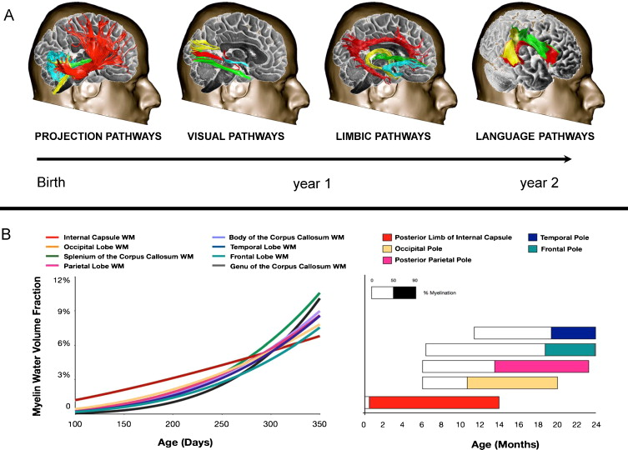
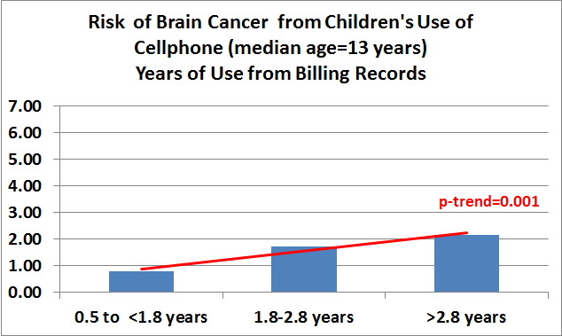
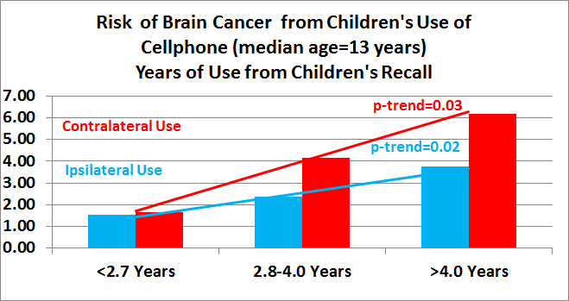
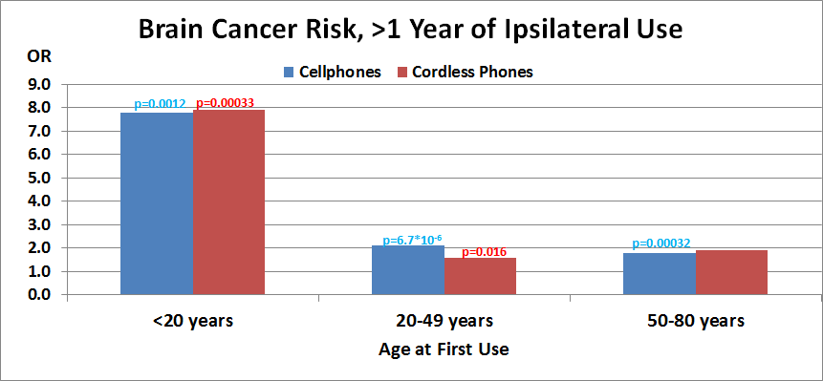
Risk of Cellphone Use by Children and Teenagers
CEFALO [6]
Hardell & Carlberg [7]
7
Notes:
Top left chart: The CEFALO study of children and adolescents (median age 13 years) found more than a doubled risk of brain cancer with >2.7 years of cellphone use based on billing records of their use (not children’s memory of their use) and a significant trend for increasing risk with increasing years of use (p=0.001). Top right chart: It also found significant risks both for ipsilateral use and contralateral use again with a significant trends. It is not clear why the contralateral risk is higher than ipsilateral risk.
Bottom chart: Swedish study of cellphone and cordless phone use found a doubled risk of brain cancer when use began as an adult. When use began as a teenager or younger there was an eight-fold increased risk of brain cancer.

Slide 8
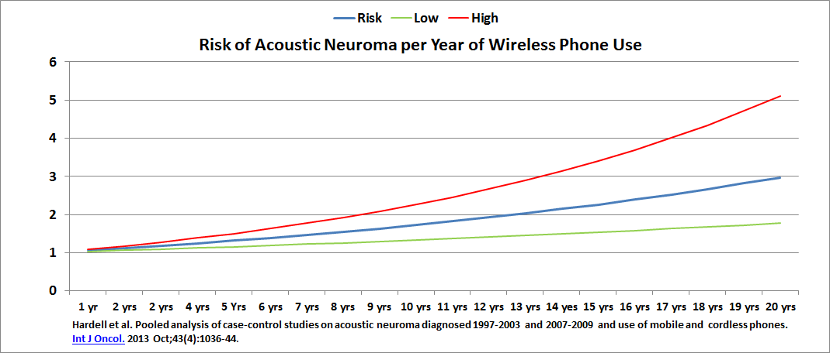
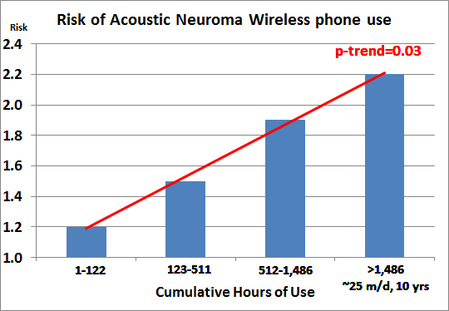
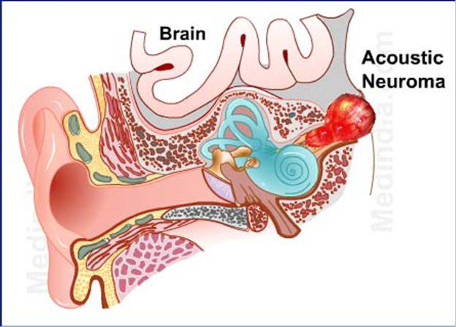
Risk of Acoustic Neuroma [8] (a hearing nerve tumor)
Notes:
8
The graph at the top show the risk and confidence intervals of getting an acoustic neuroma by the number of years a cellphone was used. The bottom left graph shows the risk as the cumulative hours of use increase. With 12 years of use the risk as doubled; at 20 years the risk has tripled.
Bottom left: Risk increase with cumulative hours of use with a significant trend of increase risk with increasing cumulative hour of use.
Bottom right: Chart indicated the anatomical location of an acoustic neuroma.

Slide 9
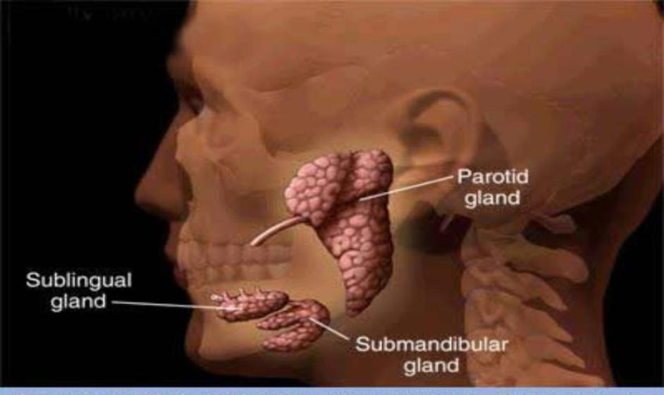
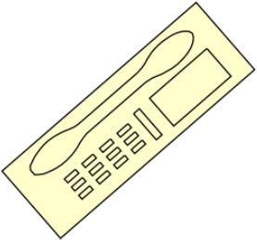
Parotid Salivary Gland Tumors Tripled in Israel: 1 in 5 is under age 20 [9]
Do not take without permission
Notes:
The largest salivary gland (parotid gland) is located in the cheek in front and below the ear. In Israel, probably the heaviest users of cellphone anywhere in the world there has been a sudden increase in parotid gland cancers. As we know cancer are far more prevalent in the elderly. In Israel, one in every five case are diagnosed in teenagerr.

Slide 10
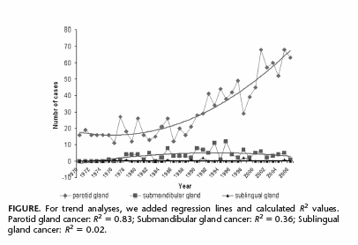
Increase in Parotid Gland Tumors in Israel Over the Last 30 Years [10]
Notes:
There are 3 salivary glands. This graph shows, for each of the 3 salivary glands, the number of cancer per year. The upper curve are parotid gland tumors.

Slide 11
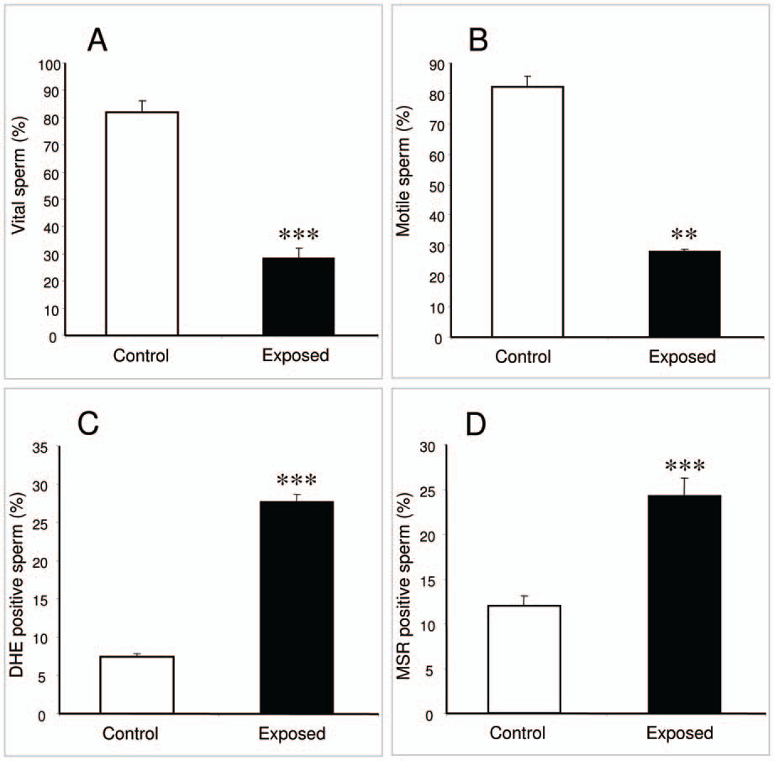
Laureate
Professor
John Aitken
Cell Phone
Exposed
Sperm
Significantly
Reduced
& Damaged
[11]
Do not take without permission
Notes:
This chart shows 4 characteristic of sperm. As you can see each characteristics is degraded when exposed to cellphone radiation compared to controls (unexposed).

Slide 12
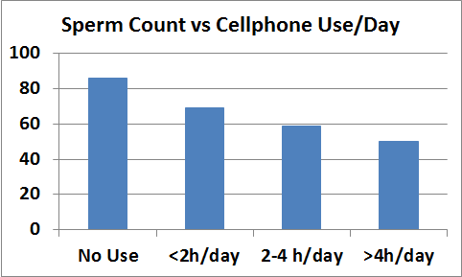
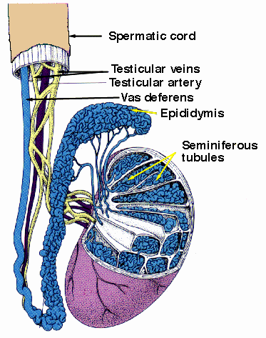
Risk of Sperm Damage [12]
Notes:
12
Here we see the sperm count decreases as the number the hours of cellphone use increases.

Slide 13
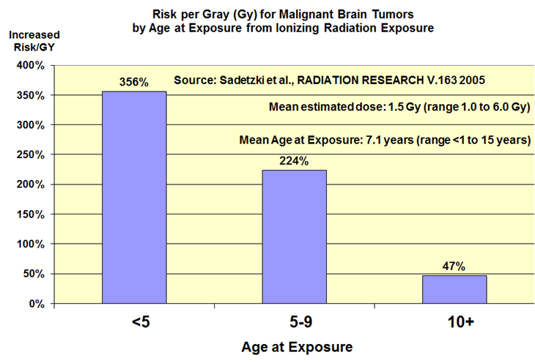
MWR Is a Class 2B Carcinogen
World Health Organization’s (WHO’s International Agency for Research on Cancer (IARC) declared MWR is a Class 2B (possible) Carcinogen [13]
285 Class 2B carcinogens including carbon tetrachloride, chloroform, DDT, lead, nickel, phenobarbital, styrene, diesel fuel, and gasoline
Should children be exposed to any of these agents including MWR?
Children are at greater risk than adults from exposure to any carcinogen
The younger child, the higher the risk [14].
Notes:
13
In May 2011 WHO declared MWR is a Class 2B (possible) carcinogen. There are 285 agents classified as a Class 2B carcinogen including the pesticide DDT, lead, gasoline and Diesel fuel
The younger a child when exposed to a carcinogen, the higher the risk. The graph, shows the increased risk of brain tumors resulting from head X-rays by 3 age groups, <5, 5-9, 10+ years (median age 7.1 years). The average time between the head X-ray and diagnosis of the brain tumor was over 30 years.

Slide 14
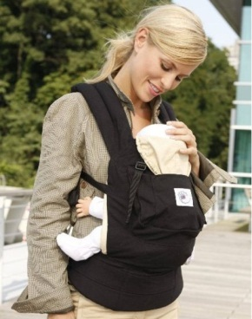
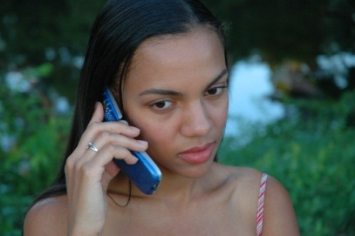
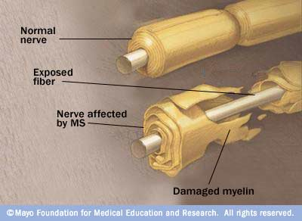
Myelin – Development of CNS electrical insulation Mary Redmayne PhD
No myelin in first half of gestation [15]
First layers develop from mid-gestation to 2 years of age [15]
It continues throughout adolescence into adulthood [15]
Deterioration due to environmental insult [16, 17]
Slide courtesy of Dr. Devra Davis
7
Notes:
Myelin protects nerve cells It begins developing at 4-5 months gestation, wrapping around the neurons in layers until a good sheath has developed in some brain areas by 2 years of age.
These illustrations indicate that the temporal lobes and cerebellum are the highest exposed parts for adults and children respectively

Slide 15
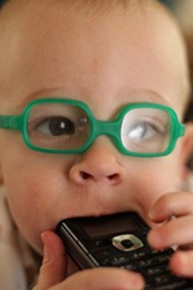
MWR Myelin Research
Very little research on effect of RF on myelin
None exploring effects on under-myelinated CNS
No age-dependent research
RESEARCH:
RF exposure, 3 GHz, 3 hours daily for 30 days (athermal doses)
Guinea pigs: 3.5 mW/cm² (SAR 0.53 W/kg )
Rabbits 5 mW/cm² (SAR 0.75 W/kg)
RESULT: Myelin degeneration and glial cell proliferation [15]
Continuous-wave RF exposure, 2.45 GHz, 5 hr/day, 5 day/week for 22 weeks
Rats : SAR 2.3 W/kg
RESULT :An increase in myelin degeneration around neurons in the brain of rats at 6 weeks after exposure [16]
Slide adapted from slide by Dr. Devra Davis
9
Notes:
Highest risk if it applies to humans is likely to be in chidren and adolescents whose temporal myelin is still poorly developed and the elderly whose myelin is already more vulnerable to deterioration leading to Alzheimer’s Disease and Multiple Sclerosis.

Slide 16
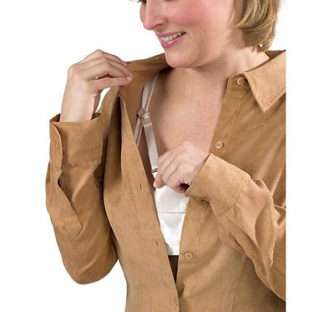
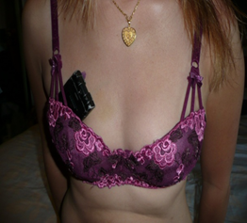
Marketing for Cell Phones and Gear in Bras
Notes:
Left: Woman placing cell phone in pocket built into bra for cellphone placement.
Right: Cellphone placement in woman’s bra who was diagnosed with multlple-primary breast cancer located beneath where the cellphone was placed.

Slide 17
Now 5 Case Reports So Far Five Young Women Breast Cancers located where cell phones were stored
Two cases = Age 21 with multi-focal tumors found where cell phones kept in bra from age
One adolescent placed cell phone in bra from age 13 to 21 when she was diagnosed with multiple primary breast cancers
John West et al [18]
Notes:
Representative imaging of patient in Case 1. Left mammogram showing clustered calcification corresponding to multiple sites of disease in Craniocaudal (a) and Mediolateral-Oblique (b) projections.MRI showing extensive non-mass enhancement in the lateral hemisphere of the left breast in segmental distribution (c).

Slide 18
Summary of 5+ Cases
Negative for BRCA1/2
No family history or other risk factors
Unusual location of multi-focal tumors where phones were kept with mix of tubular/solid patterns of identical nuclear morphology & grade
No significant histology in ductal and lobular units away from the areas of cellular phone use
Notes:
The BRCA1 and BRCA2 gene substantially raises the risk of breast cancer
Family history of breast cancer increase the risk
Most breast cancer are on outer upper quadrant, these are beneath where the cellphone was placed

Slide 19
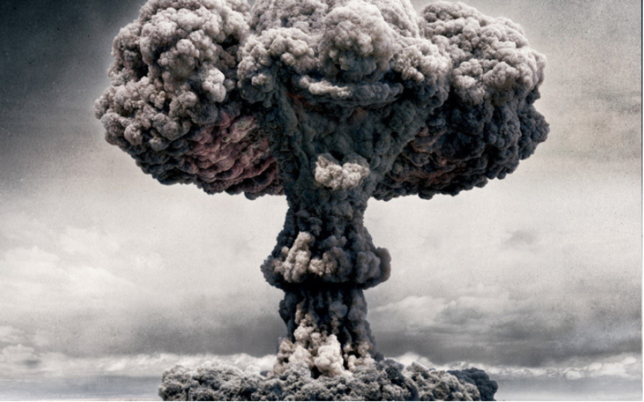
Atomic Bombs in Japan, 1945
No increase in brain tumors was found in survivors
until 40 years later [19]
Do not take without permission
Notes:
After the atomic bombs ended the Second World War, the survivors of this massive blast of ionizing radiation showed no increase in brain cancer. Of tremendous concern to scientists is the delayed nature of tumor formation related to radiation exposure. Brain cancer rates increased in those who survived atomic bomb blasts, but only showed up 40 years later.

Slide 20
Fine Print Warnings
(iPhone 4)
(BlackBerry Torch)
“(including the abdomen of pregnant women and the lower abdomen of teenagers)”
Notes:
Pay attention to the fine print warnings on your mobile communications devices. You may be surprised by what you read!

Slide 21
Cellphone Manual Warnings
(iPhone 5)
No longer a printed manual, but embedded
within the iPhone 5
Users must go to:
Settings, and scroll down to
General then scroll to the bottom to
About, and go to
Legal, and scroll down to
RF [MWR] Exposure
“To reduce exposure to RF energy [radiation], use a hands-free option, such as the built-in speakerphone, the supplied headphones, or other similar accessories. Carry iPhone at least 10 mm away from your body to ensure exposure levels remain at or below the as-tested [exposure limit] levels.”
Notes:
Apple no long prints (in very small print size) warnings. The warning are buried deep into a manual available within the phones. How many of you have an iPhone? Please take it out and turn it on.

Slide 22
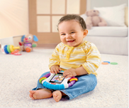
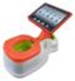
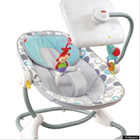
Toys for Infants and Toddlers
Wireless devices are not toys
An iPad placed within a rattle. Note the device is immediately over the boy’s reproductive organs.
Toilet training “iPotty” with iPad
An iPad for entertaining a baby
WHY ARE SUCH TOYS ALLOWED?

Slide 23
Digital Dementia & FOMO
FOMO “fear of missing out.” FOMO is considered a form of social anxiety—a compulsive concern that one might miss an opportunity for social interaction, a novel experience, or some other satisfying event. FOMO reflects a worry that friends may be having rewarding experiences from which one is absent [20]
Digital dementia: “Concerns continue to increase in South Korea. Researchers are now concerned with ‘digital dementia,’ a term coined in that country to describe a deterioration in cognitive abilities frequently seen in people who have suffered head trauma or brain diseases. South Korean physicians studying this phenomenon say that heavy Internet use may overdevelop the left side of the brain and leave the right side underdeveloped. Attention and memory span are affected, along with impulse control. Many heavy Internet users, which includes 18% of those between 10 and 19 years of age who use their smartphones for more than seven hours a day, cannot perform simple memory tasks such as recalling their own phone numbers.” [20]
Notes:
A review study focused on two problems from cellphone use in school children.
FOMO: Fear Of Missing Out
Digital Dementia: cognitive problems similar to what is seen in head trauma and brain tumors; cellphone use >7 hours/day, age 10-19 years cannot perform simple memory recall.

Slide 24
Government Warnings
Turkey 2013:
Governor Aksoy Huseyin, of the Samsun province announced he would launch a cell phone campaign to bring awareness of their hazards.
Belgium 2013:
The Public Health Minister bans cell phone sales for children under 7 years old. Advertisements are also banned during children’s TV programs.
Australia 2013:
The federal government created a fact sheet providing citizens ways to reduce exposure from wireless devices. The agency advises parents to limit children’s exposure to cell phones.
France, 2010
Ban advertising to children under 12 years of age
Ban phones designed for use under 6 years of age
Post SAR for all cellphones
City of Lyon advertisement campaign to discourage children’s use of cellphones
Do not take without permission
Notes:
Here are examples of what some governments have done to warn their citizens and in some cases passed laws banning sales to young children and banning certain types of advertisements.

Slide 25
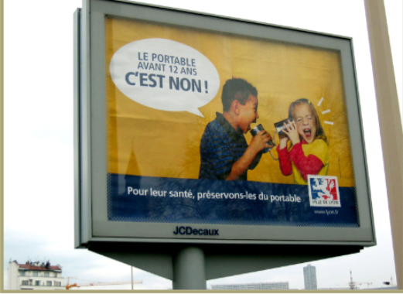
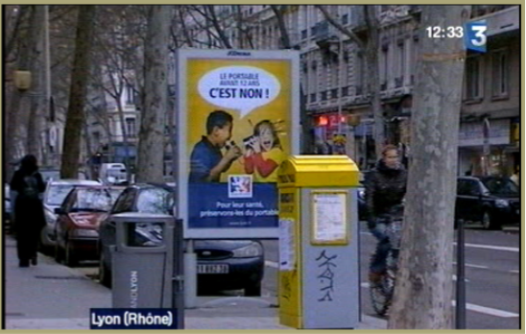
FRANCE, DECEMBER 2008
Notes:
Other countries, particularly France, have taken even stronger actions. For example, in 2008, the city of Lyon, France launched a major campaign to discourage mobile phone use among children.

Slide 26
References
1. Gandhi, O. P., Lazzi, G., Furse, C. M. (1996). Electromagnetic absorption in the human head and neck for mobile telephones at 835 and 1900 MHz. IEEE Trans. Microwave Theor. Techniq. 44(10):1884–1897.
2. Wiart et al. (2008). Analysis of RF exposure in the head tissues of children and adults. Phys. Med. Biol. 53(13):3681–3695.
3. Christ et al. Age-dependent tissue-specific exposure of cell phone users. Phys. Med. Biol. 2010 55:1767–1783.
Kuster, N. Past, current, and future research on the exposure of children. Foundation for Research on Information Technology in Society 2009
Gandhi et al. Exposure Limits: The Underestimation of Absorbed Cell Phone Radiation, Especially in Children. Electromagn Bio Med 2012 Mar;31(1):34-51.
Aydin et al. Mobile Phone Use and Brain Tumors in Children and Adolescents: A Multicenter Case-Control Study. J. Natl Cancer Inst. 2011 Aug 17; 103(16): 1264-76.
Hardell & Carlberg. Mobile Phones, Cordless Phones and the Risk for Brain Tumours. Int. J. Oncol. 2009 Jul; 35(1): 5-17.
Hardell et al. Pooled analysis of case-control studies on acoustic neuroma diagnosed 1997-2003 and 2007-2009 and use of mobile and cordless phones. Int J Oncol. 2013 Oct;43(4):1036-44.
Dan Even. Haaretz Jul. 16, 2009. http://www.haaretz.com/print-edition/news/israeli-study-sees-link-between-oral-cancer-cell-phones-1.280073 (Accessed 9 April 2010).
Czerninski et al. Risk of Parotid Malignant Tumors in Israel (1970–2006). Epidemiology. 2011 Jan;22(1):130-1.
De Iulliis et al. Mobile Phone Radiation Induces Reactive Oxygen Species Production and DNA Damage in Human Spermatoza. PLOS ONE Jul 31 2009; 4(7).
Agarwal et al. Effect of cell phone usage on semen analysis in men attending infertility clinic: an observational study. Fertil Steril. 2008 Jan;89(1):124-8.
Baan et al. Carcinogenicity of radiofrequency electromagnetic fields. The Lancet Oncology, Volume 12, Issue 7, Pages 624 - 626, July2011.
Sadetzki et al. Long-Term Follow-up for Brain Tumor Development after Childhood Exposure to Ionizing Radiation for Tinea Capitis. Radiat Res. 2005 Apr;163(4):424-32.
6. Spencer A Rathus. Childhood: Voyages in Development, Fifth Edition, Publisher Wadsworth, Belmont, CA, USA.
7. Baranski S. Histological and histochemical effects of microwave irradiation on the central nervous system of rabbits and guinea pigs. Am J Physiol Med 1972;51:182-90.
8. Switzer WG, Mitchell DS. Long-term effects of 2.45 GHz radiation on the ultrastructure of the cerebral cortex and hematologic profiles of rats. Radio Sci 1977;12:287-93
30+ y
Notes:
26
Upon request, I can sent you copies of these references.

Slide 27
References
Spencer A Rathus. Childhood: Voyages in Development, Fifth Edition, Publisher Wadsworth, Belmont, CA, USA.
Baranski S. Histological and histochemical effects of microwave irradiation on the central nervous system of rabbits and guinea pigs. Am J Physiol Med 1972;51:182-90.
Switzer WG, Mitchell DS. Long-term effects of 2.45 GHz radiation on the ultrastructure of the cerebral cortex and hematologic profiles of rats. Radio Sci 1977;12:287-93
Case Report, Multifocal Breast Cancer in Young Women with Prolonged Contact between Their Breasts and Their Cellular Phones. Case Rep Med. 2013;2013:354682
Sudamori et al. Incidence of intracranial meningiomas in Nagasaki atomic-bomb survivors. Int J Cancer. 1996 Jul 29;67(3):318-22.
Dossey L. FOMO, Digital Dementia, and Our Dangerous Experiment. Explore (NY). 2014 Mar-Apr;10(2):69-73.
Notes:
27

Slide 28
Thank You (Copies available on request)

